Slide 1
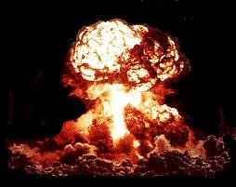
POST WW2 CAUSES OF THE COLD WAR

Slide 2
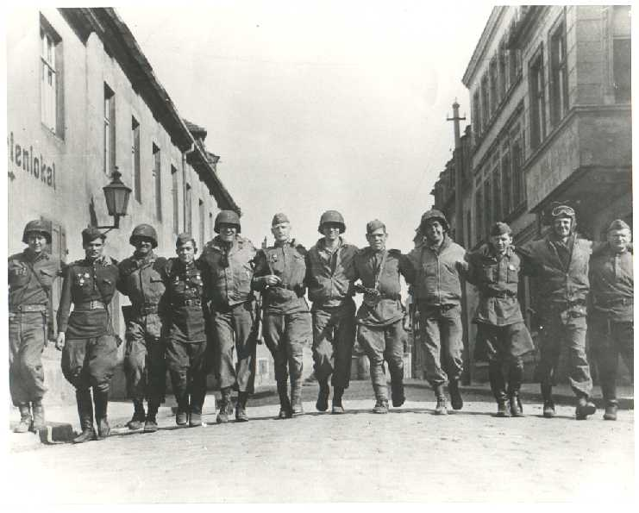
FRIENDS FOR NOW

Slide 3
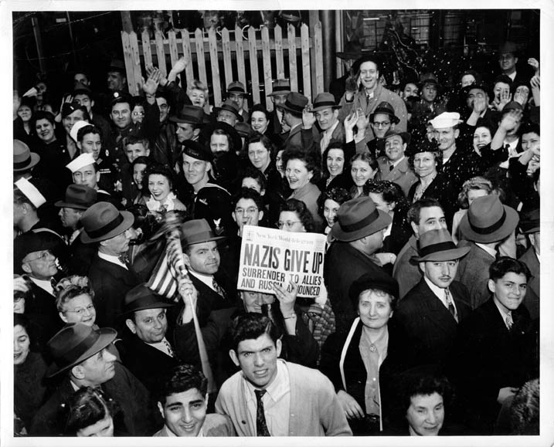

Slide 4
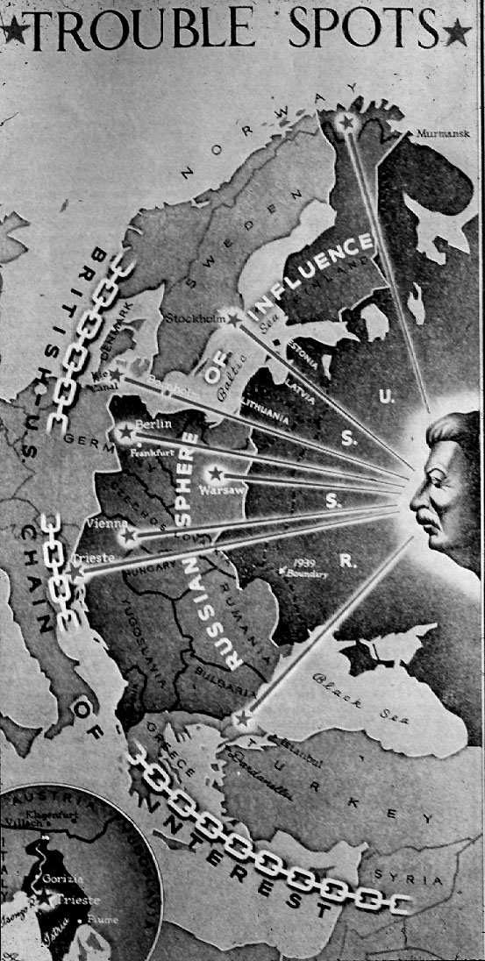

Slide 5
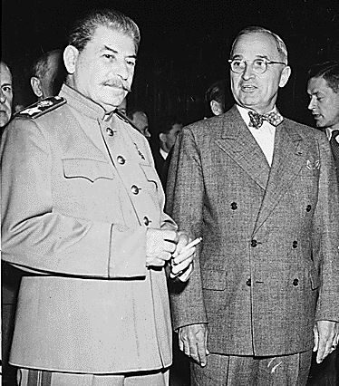
War of the Wills
Truman is determined not to appease Stalin & wants access to E. Euro markets.
Stalin is determined to make E. Euro a buffer zone between USSR & Germany in case of a 3rd invasion.
@ Potsdam Con Truman tried diplomatic hardline w/Stalin after learning of A-Bomb, but it failed.

Slide 6
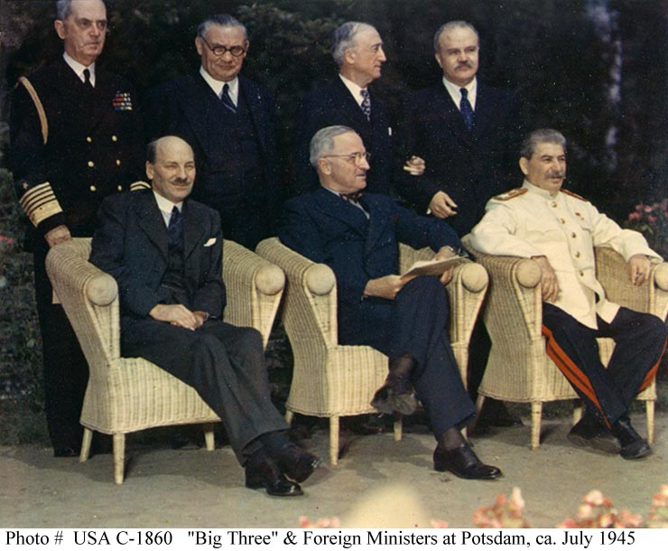
Truman agreed to Sov SoI in E. Euro & US SoI in W. Euro @ Potsdam Con, but publicly denies it after.
Truman & Stalin don’t trust each other.

Slide 7
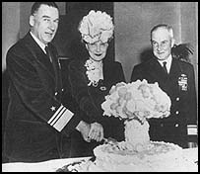
THE ATOMIC BOMB
US only country w/ A-Bomb & won’t share it.
UK provided supplies & scientists to Manhattan Project, get nothing in return
USSR has spies in US, & German scientists.
Race for the bomb continues

Slide 8
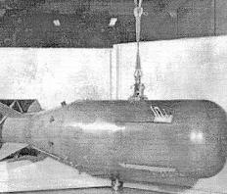

Slide 9
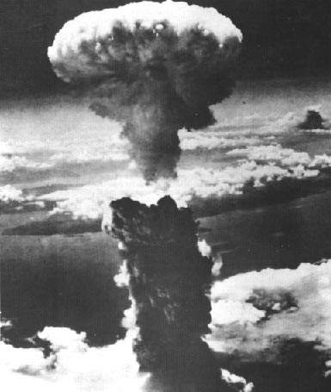

Slide 10
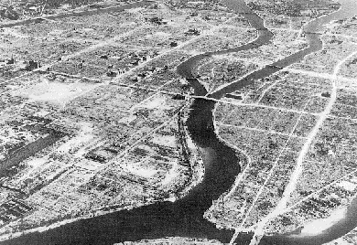

Slide 11
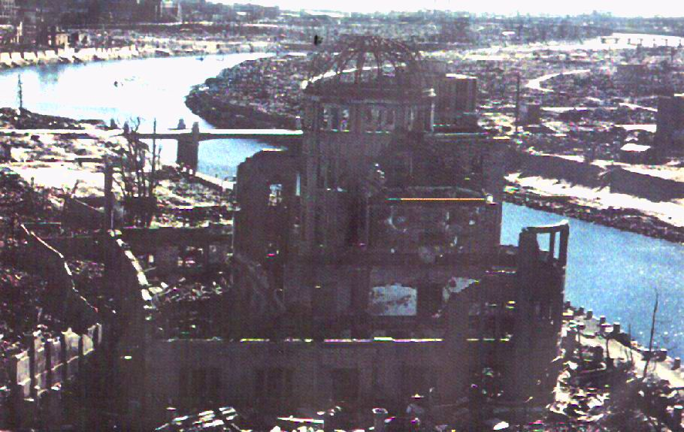

Slide 12
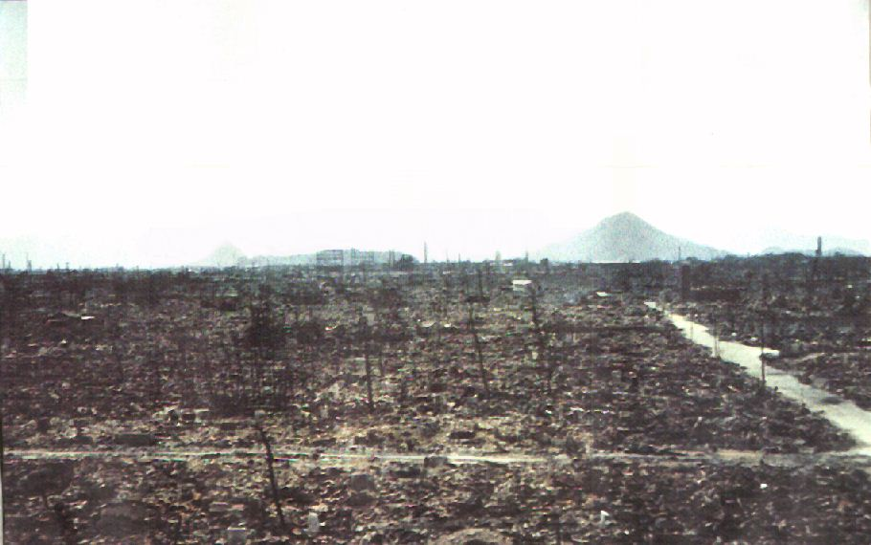

Slide 13
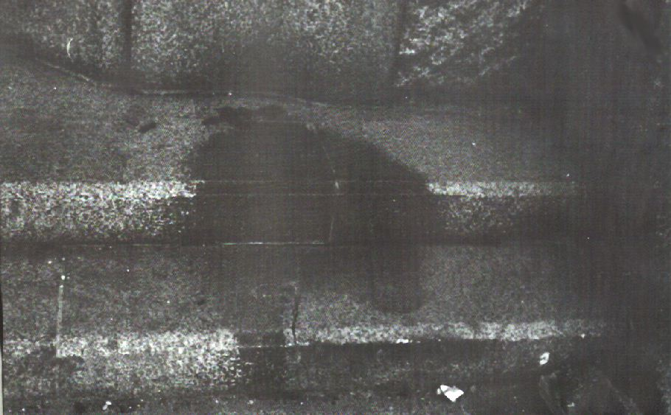

Slide 14
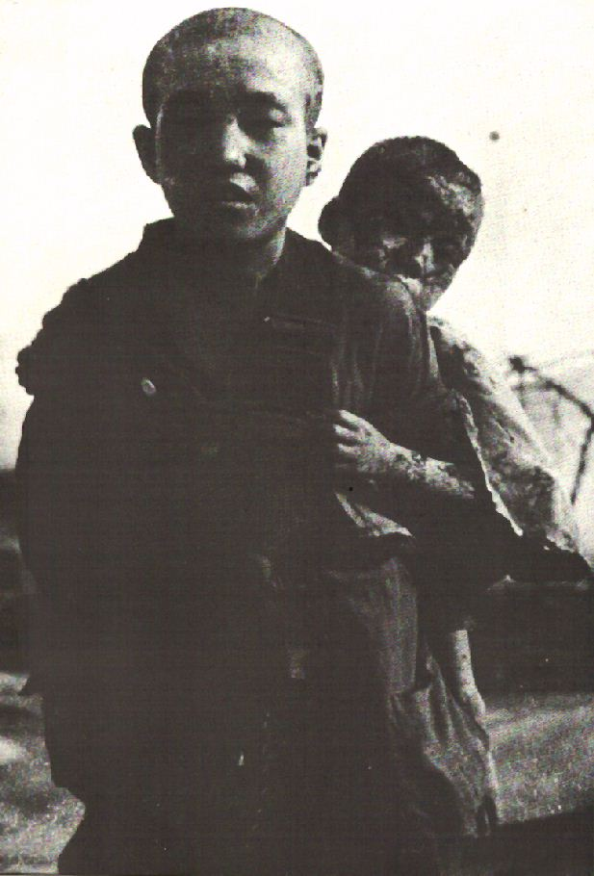

Slide 15
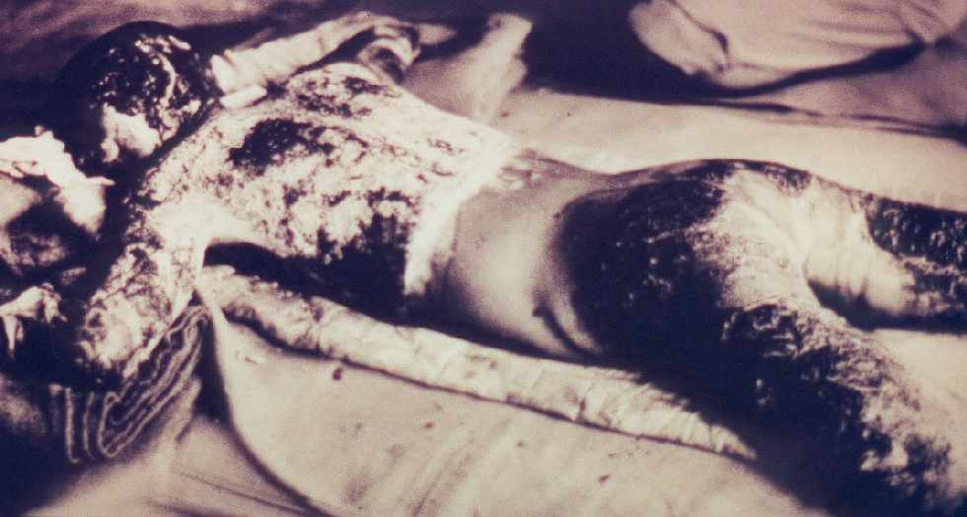

Slide 16
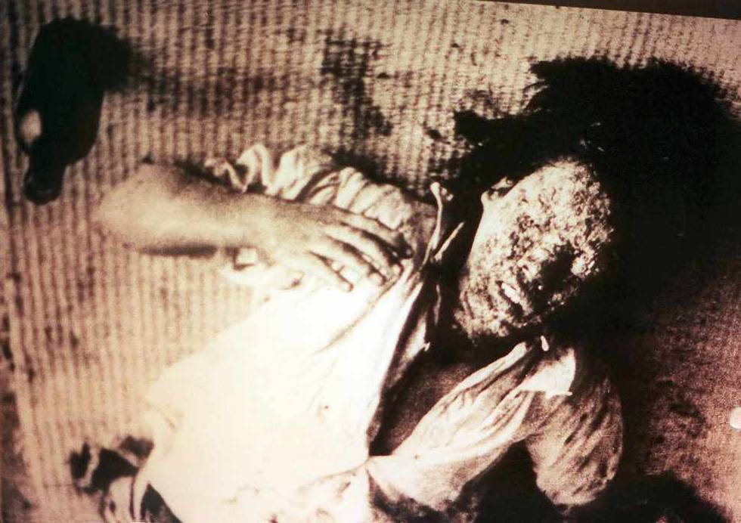

Slide 17
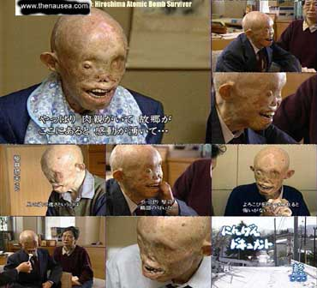

Slide 18
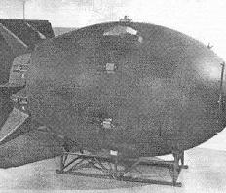

Slide 19
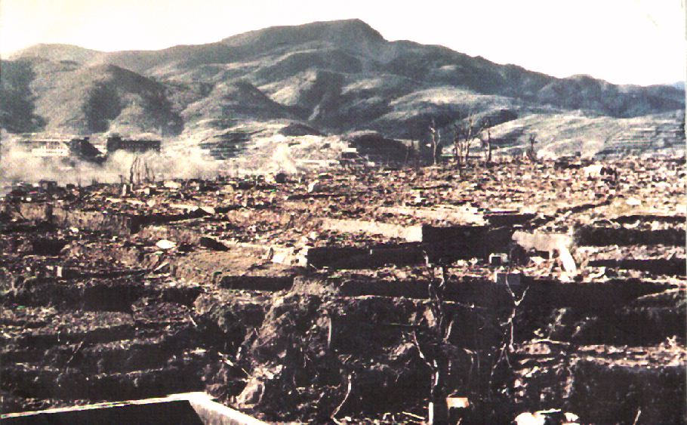

Slide 20
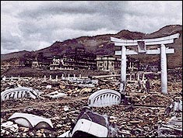

Slide 21
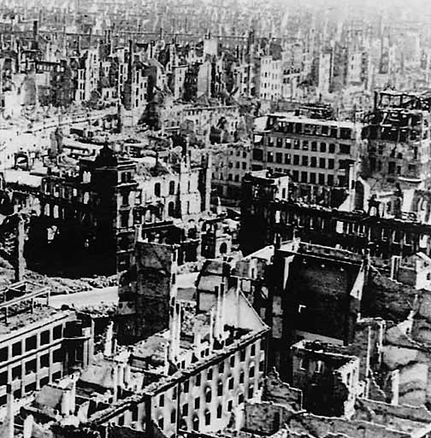
EUROPE DESTROYED
Europe is in ruins & needs to be re-built
US Lend Lease Aid ended with the war.
Who will pay to rebuild Europe & what will the terms be?

Slide 22

Communism vs. Americanism in Europe
Both US & USSR popular with the people of W. Euro.
Commie parties of France, Italy, & Greece popular from Partisan resistance vs. Germans.

Slide 23
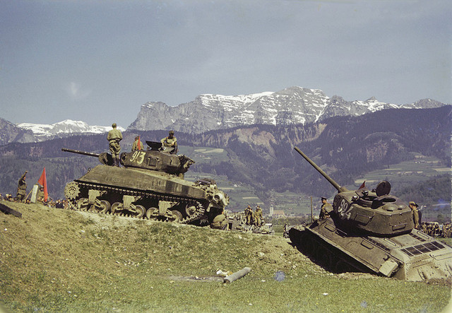
However, US Anti-Imperial stance & end of Lend-Lease leaves Allied leaders w/ weak US support.

Slide 24
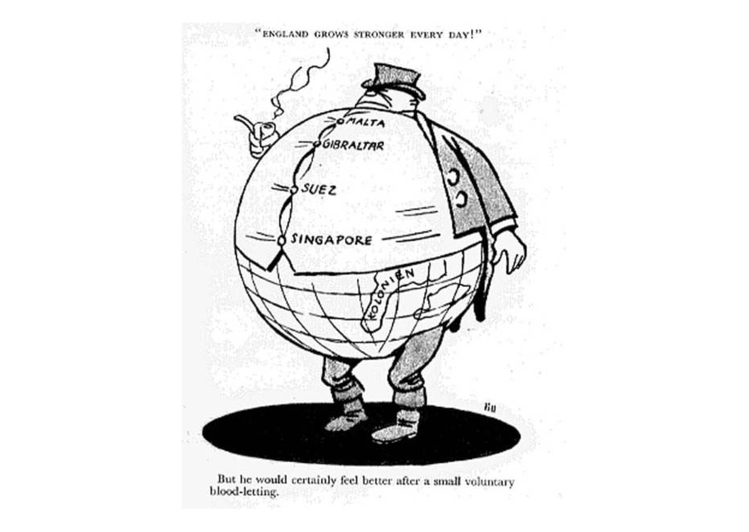
Imperialism weakened
During WW2, Allied Euro countries promised colonies independence in return for support.
Euro countries need colonies to rebuild
New Brit gov willing to give up: Greece, Egypt, Palestine, & India
France determined to keep Algeria & Indochina
Belgium determined to keep Congo
Holland determined to keep Indonesia

Slide 25
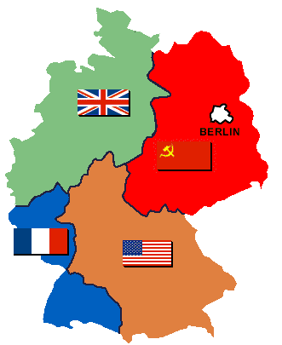
HOT SPOT: GERMANY
Germany & Berlin divied into 4 Zones [US, USSR, GB, FR]
US/UK want eventual re-unification
France wants to annex its portion.

Slide 26
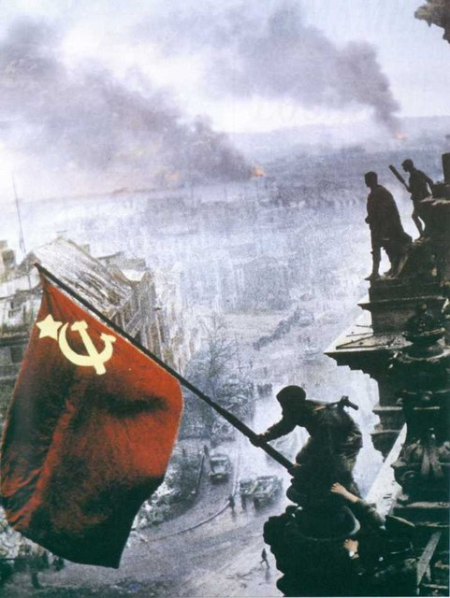
USSR wants a weak, divided Germany.
Berlin located in USSR Zone.
The 4 Powers could not agree on a re-unification plan.

Slide 27
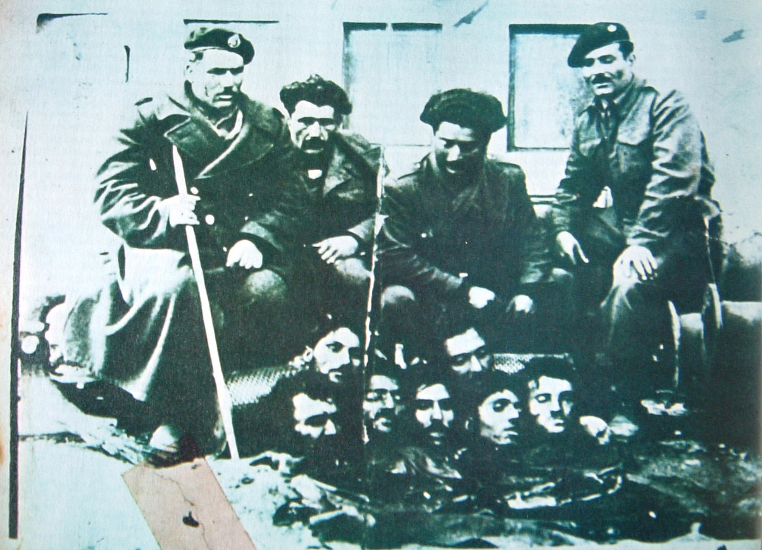
HOT SPOT: GREECE
Greek Civil War between Commies supported by Yugoslavia & Royalists supported by Britain.
US/UK believed Yugoslavia was a puppet of USSR, it was not.
Britain could not afford to keep their army in Greece much longer.

Slide 28
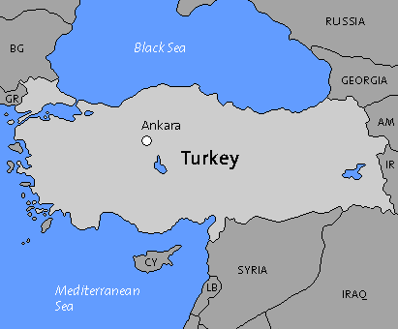

HOTSPOT: TURKEY
Stalin wanted naval base @ Istanbul, access to Med Sea, & northeastern provinces of Turkey.
All part of historical Russo/Turkish conflict

Slide 29
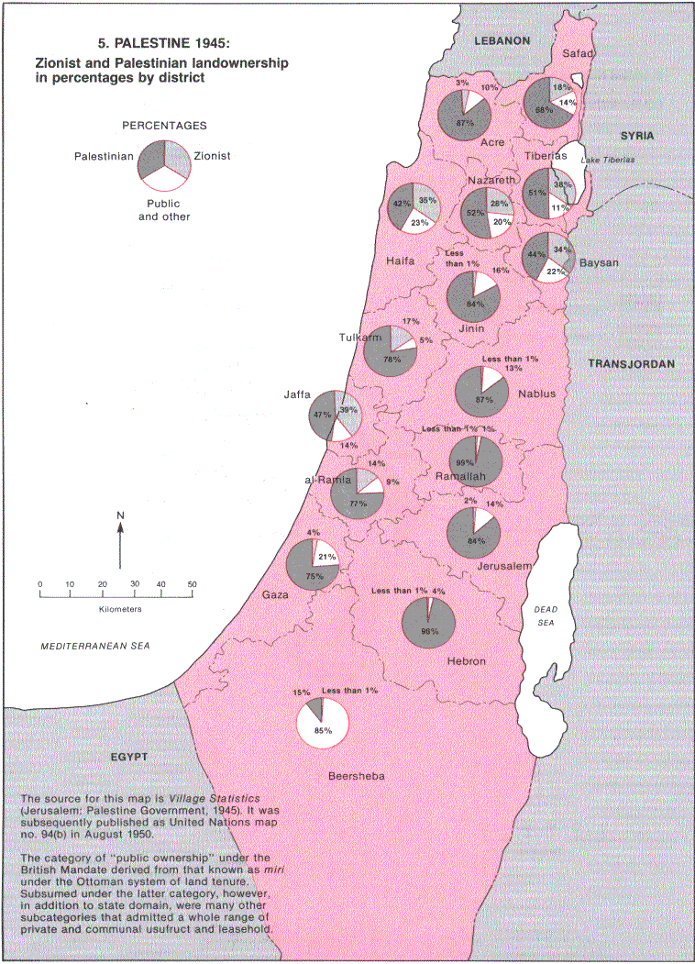
HOTSPOT: Palestine
Massive Jewish exodus from E. Euro after WW2, fear of commie spies.
Socialist ideology of Zionism suspect in USA vs. large Jewish voting bloc in USA
Prompted equal/opposite Palestinian nationalism
Attacks vs Brits slowly weakens UK resolve to remain.

Slide 30
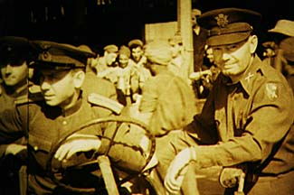
HOTSPOT: IRAN
Iran occupied by UK/USSR/US
US military leaves, but US advisers stay.
Iranians want UK & USSR out too.
USSR promoting Azeri & Kurdish nationalism in north
UK promoting Arab rebellion in south.

Slide 31
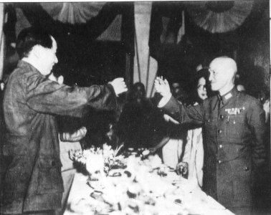
HOT SPOT: CHINA
Chinese Civil War re-ignites between rival dictators [Commie Mao & Kaishek].
Both supported by US VS. Japan during WW2.
US ends support for Mao after WW2, but continues support for Kaishek.
MAO
SHIANG

Slide 32
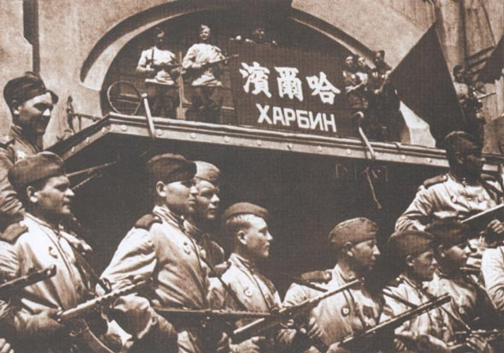
USSR gives Manchuria to Mao to fight vs. Kaishek.

Slide 33
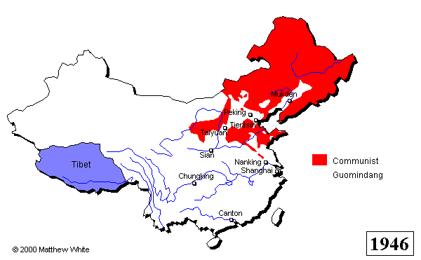
Chinese Civil War
Area ruled by minor warlords
Nationalist
Area of
Control

Slide 34
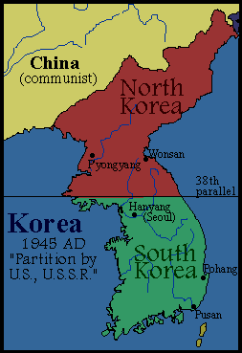
HOT SPOT: KOREA
Japan still controlled most of Korea when it surrendered.
US & USSR agreed to share occupation.
US south of 38th Parallel, USSR north of it.
There was no re-unification plan

Slide 35
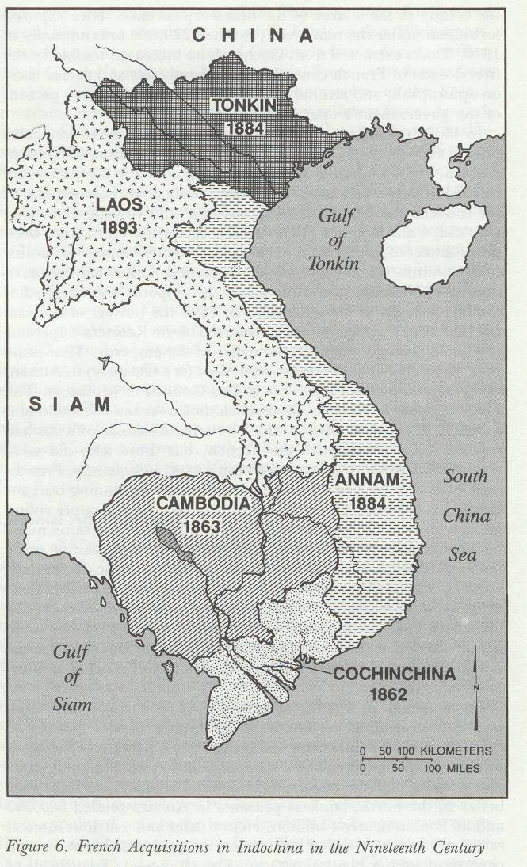
HOTSPOT: INDOCHINA
Ho Chi Minh & Vietnamese want independence.
Ho was a Commie w/o support from USSR, offering US a naval base & open markets.
France wants its colony back.
US dilemma, support nationalism or imperialism?
FRENCH INDOCHINA

Slide 36
SUMMARY: Post ww2 CAUSES OF THE COLD WAR
THE US & USSR EMERGE AS THE TWO MAJOR POWERS AFTER WW2, w/ UK A WEAK 3RD.
ALL 3 HAVE DIFFERENT IDEAS HOW THE POST WAR WORLD SHOULD LOOK.
TRUMAN & STALIN DON’T TRUST EACHOTHER.
THERE IS DISAGREMMENT AND MISTRUST CONCERNING: REBUILIDNG EUROPE, RE-UNIFYING GERMANY & KOREA, THE CIVIL WARS IN GREECE & CHINA, OCCUPATION OF PALESTINE & IRAN, CONTROL OF THE A-BOMB, AND SUPPORT FOR COLONIES IN ASIA & AFRICA

